Slide 1

Analytics, Data Science and A I: Systems for Decision Support
Eleventh Edition
Chapter 7
Text Mining, Sentiment Analysis, and Social Analytics
Copyright © 2020, 2015, 2011 Pearson Education, Inc. All Rights Reserved
Notes:
If this PowerPoint presentation contains mathematical equations, you may need to check that your computer has the following installed:
1) Math Type Plugin
2) Math Player (free versions available)
3) NVDA Reader (free versions available)

Slide 2
Learning Objectives (1 of 2)
7.1 Describe text mining and understand the need for text mining
7.2 Differentiate among text analytics, text mining and data mining
7.3 Understand the different application areas for text mining
7.4 Know the process of carrying out a text mining project
7.5 Appreciate the different methods to introduce structure to text-based data 7.6 Describe sentiment analysis
Notes:
Slide 2 is list of textbook LO numbers and statements

Slide 3
Learning Objectives (2 of 2)
7.7 Develop familiarity with popular applications of sentiment analysis
7.8 Learn the common methods for sentiment analysis
7.9 Become familiar with speech analytics as it relates to sentiment analysis
7.10 Learn three facets of Web analytics—content, structure, and usage mining
7.11 Know social analytics including social media and social network analyses
Notes:
Slide 2 is list of textbook LO numbers and statements

Slide 4
Text Mining Concepts (1 of 2)
85-90 percent of all corporate data is in some kind of unstructured form (e.g., text)
Unstructured corporate data is doubling in size every 18 months
Tapping into these information sources is not an option, but a need to stay competitive
Text mining
A semi-automated process of extracting knowledge from unstructured data sources
a.k.a. text data mining or knowledge discovery in textual databases

Slide 5
Text Mining Concepts (2 of 2)
Benefits of text mining are obvious especially in text-rich data environments
e.g., law (court orders), academic research (research articles), finance (quarterly reports), medicine (discharge summaries), biology (molecular interactions), technology (patent files), marketing (customer comments), etc.
Electronic communication records (e.g., Email)
Spam filtering
Email prioritization and categorization
Automatic response generation

Slide 6
Text Analytics (1 of 2)
Text analytics a broader concept that that includes information retrieval, text mining, data mining, web mining, and NLP.
Information retrieval is searching and identifying relevant documents for a given set of key terms.

Slide 7
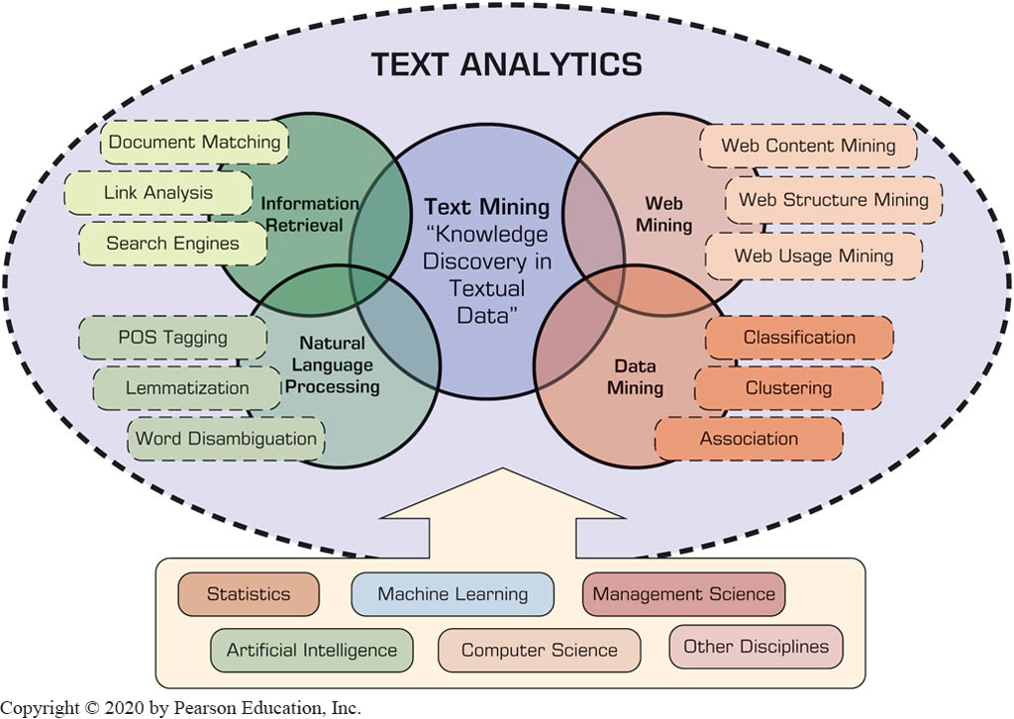
Text Analytics (2 of 2)
Figure 7.2 Text Analytics, Related Application Areas, and Enabling Disciplines.

Slide 8
Data Mining versus Text Mining
Both seek for novel and useful patterns
Both are semi-automated processes
Difference is the nature of the data:
Structured versus unstructured data
Structured data: in databases
Unstructured data: Word documents, P D F files, text excerpts, X M L files, and so on
To perform text mining – first, impose structure to the data, then mine the structured data.

Slide 9
Text Mining Application Areas (1 of 2)
Information extraction
Identifying key phrases and relationships within text by looking for predefined objects and sequences in text by way of pattern matching.
Topic tracking
Identifying key phrases and relationships within text by looking for predefined objects and sequences in text by way of pattern matching.
Summarization
Summarizing a document to save the reader time.
Categorization
Identifying the main themes of a document and then placing the document into a predefined set of categories based on those themes.

Slide 10
Text Mining Application Areas (2 of 2)
Clustering
Grouping similar documents without having a predefined set of categories.
Concept linking
Grouping similar documents without having a predefined set of categories.
Question answering
Finding the best answer to a given question through knowledge-driven pattern matching.

Slide 11
Text Mining Terminology (1 of 5)
Unstructured or semistructured data
Corpus (and corpora)
a large and structured set of texts (now usually stored and processed electronically) prepared for the purpose of conducting knowledge discovery.
Terms
A term is a single word or multiword phrase extracted directly from the corpus of a specific domain by means of NLP methods.
Concepts
Concepts are features generated from a collection of documents by means of manual, statistical, rule-based, or hybrid categorization methodology. Compared to terms, concepts are the result of higher-level abstraction.

Slide 12
Text Mining Terminology (2 of 5)
Stemming
The process of reducing inflected words to their stem (or base or root) form. For instance, stemmer, stemming, stemmed are all based on the root stem.
Stop words (or, noise words)
Are words that are filtered out prior to or after processing natural language data (like: a, an, the, of, on, etc.)
Synonyms
Synonyms are syntactically different words (i.e., spelled differently) with identical or at least similar meanings (e.g., movie, film, and motion picture).

Slide 13
Text Mining Terminology (3 of 5)
Polysemes (or, homonyms):
Syntactically identical words (i.e., spelled exactly the same) with different meanings (e.g., bow can mean “to bend forward,” “the front of the ship,” “the weapon that shoots arrows.”
Tokenizing
A token is a categorized block of text in a sentence. The block of text corresponding to the token is categorized according to the function it performs.
Term dictionary
a collection of terms specific to a narrow field that can be used to restrict the extracted terms within a corpus.

Slide 14
Text Mining Terminology (4 of 5)
Word frequency
The number of times a word is found in a specific document.
Part-of-speech tagging
the process of marking the words in a text as corresponding to a particular part of speech (nouns, verbs, adjectives, adverbs, etc.) based on a word’s definition and the context in which it is used.
Morphology
This is the branch of the field of linguistics and a part of NLP that studies the internal structure of words (patterns of word formation within a language or across languages).

Slide 15
Text Mining Terminology (5 of 5)
Term-by-document matrix (or, Occurrence matrix)
the common representation schema of the frequency-based relationship between the terms and documents in tabular format where terms are listed in columns, documents are listed in rows, and the frequency between the terms and documents is listed in cells as integer values.
Singular value decomposition (or, Latent semantic indexing)
This dimensionality reduction method is used to transform the term-by-document matrix to a manageable size by generating an intermediate representation of the frequencies using a matrix manipulation method.

Slide 16
Natural Language Processing (N L P) (1 of 4)
N L P is …
a very important concept in text mining
a subfield of artificial intelligence and computational linguistics
the studies of "understanding" the natural human language

Slide 17
Natural Language Processing (N L P) (2 of 4)
What is “Understanding” ?
Human understands, what about computers?
Natural language is vague, context driven
True understanding requires extensive knowledge of a topic
Can/will computers ever understand natural language the same/accurate way we do?

Slide 18
Natural Language Processing (N L P) (3 of 4)
Challenges in N L P
Issues related to spoken language and different meanings of words and the context in which the words are spoken.
Dream of A I community
to have algorithms that are capable of automatically reading and obtaining knowledge from text

Slide 19
Natural Language Processing (N L P) (4 of 4)
WordNet
A laboriously hand-coded database of English words, their definitions, sets of synonyms, and various semantic relations between synonym sets.
Very expensive to build and maintain manually
A major resource for N L P applications.
Need automation to be completed.
Area where WordNet has shown impact is in CRM and sentiment analysis.
Sentiment Analysis
A technique used to detect favorable and unfavorable opinions toward specific products and services

Slide 20
N L P Task Categories
Question answering
Automatic summarization
Natural language generation
Natural language understanding
Machine translation
Foreign language reading & writing
Speech recognition
Text to Speech
Text proofing
Optical character recognition

Slide 21
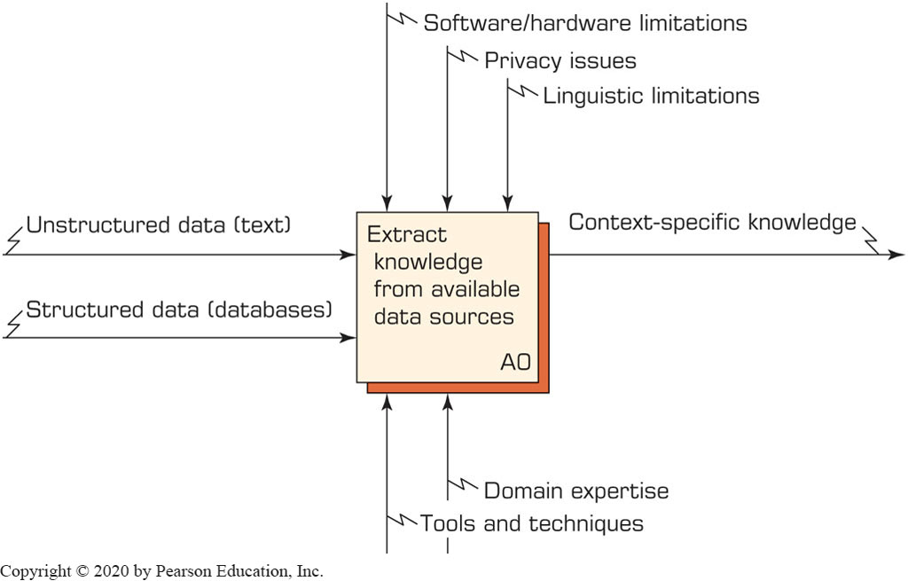
Text Mining Process (1 of 7)
A Context Diagram for Text Mining Process
Controls (constraints)
Input
Output
Mechanisms

Slide 22
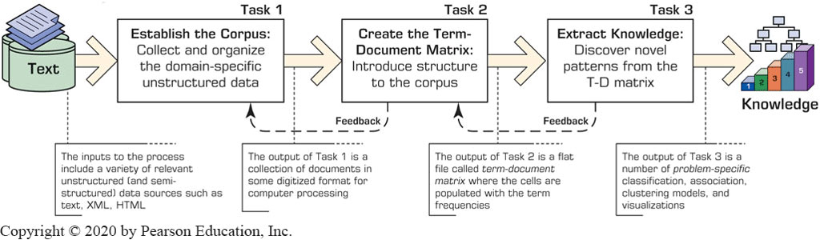
Text Mining Process (2 of 7)
Figure 7.6 The Three-Step/Task Text Mining Process.
Example:
ASCII text files

Slide 23
Text Mining Process (3 of 7)
Step 1: Establish the corpus
Collect all relevant unstructured data (e.g., textual documents, X M L files, emails, Web pages, short notes, voice recordings…)
Digitize, standardize the collection (e.g., all in A S C I I text files)
Place the collection in a common place (e.g., in a flat file, or in a directory as separate files)

Slide 24
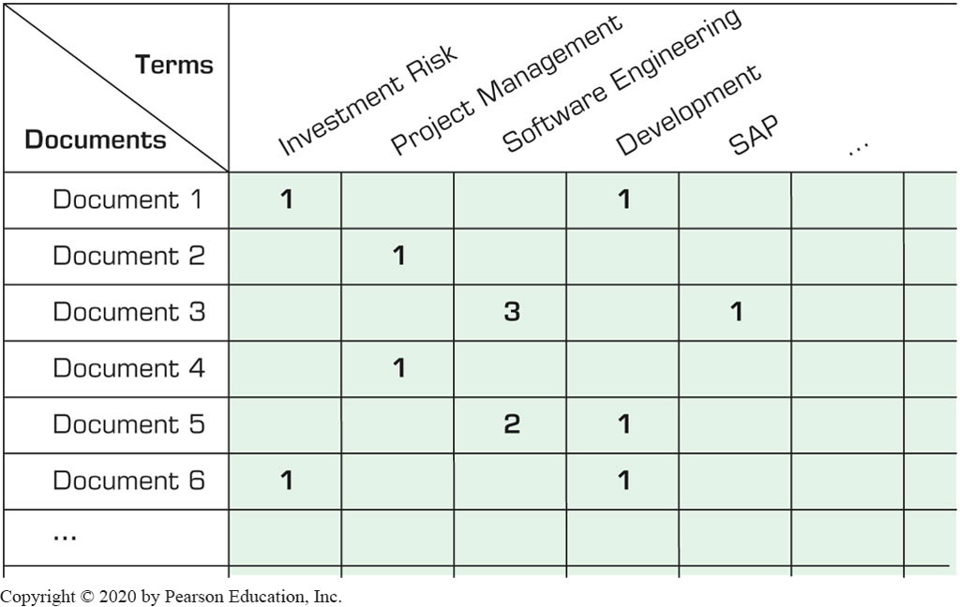
Text Mining Process (4 of 7)
Step 2: Create the Term–by–Document Matrix

Slide 25
Text Mining Process (5 of 7)
Step 2: Create the Term–by–Document Matrix (T D M) (Cont.)
Should all terms be included?
Stop words, include words
Synonyms, homonyms
Stemming

Slide 26
Text Mining Process (6 of 7)
Step 2: Create the Term–by–Document Matrix (T D M) (Cont.)
T D M is a sparse matrix. How can we reduce the dimensionality of the T D M?
Manual - a domain expert goes through it
Eliminate terms with very few occurrences in very few documents
Transform the matrix using singular value decomposition (S V D)

Slide 27
Text Mining Process (7 of 7)
Step 3: Extract patterns/knowledge
Classification (text categorization)
Clustering (natural groupings of text)
Association
Trend Analysis (…)

Slide 28
Sentiment Analysis
Sentiment → belief, view, opinion, and conviction
Sentiment analysis is trying to answer the question “What do people feel about a certain topic?”
By analyzing data related to opinions of many using a variety of automated tools
Used in variety of domains, but its applications in C R M are especially noteworthy (related to customers/consumers’ opinions)

Slide 29
Sentiment Analysis Applications
Voice of the customer (V O C)
Voice of the Market (V O M)
Voice of the Employee (V O E)
Brand Management
Financial Markets
Politics
Government Intelligence
E-commerce Site Design
Email Filtering

Slide 30
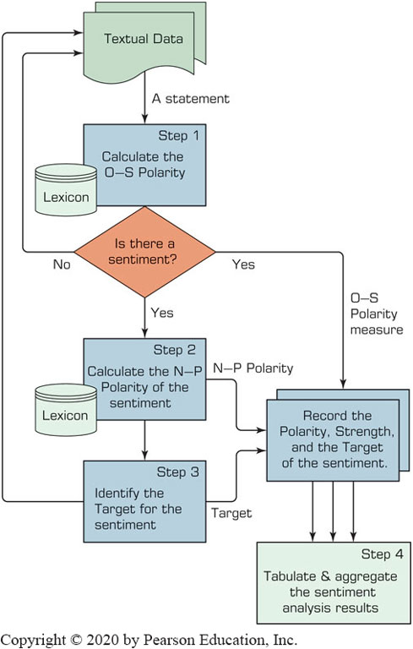
Sentiment Analysis Process (1 of 3)

Slide 31
Sentiment Analysis Process (2 of 3)
Step 1 – Sentiment Detection
Comes right after the retrieval and preparation of the text documents
It is also called detection of objectivity
Fact [= objectivity] versus Opinion [= subjectivity]
Step 2 – N-P Polarity Classification
Given an opinionated piece of text, the goal is to classify the opinion as falling under one of two opposing sentiment polarities
N [= negative] versus P [= positive]

Slide 32
Sentiment Analysis Process (3 of 3)
Step 3 – Target Identification
The goal of this step is to accurately identify the target of the expressed sentiment (e.g., a person, a product, and event, etc.)
Level of difficulty → the application domain
Step 4 – Collection and Aggregation
Once the sentiments of all text data points in the document are identified and calculated, they are to be aggregated
Word → Statement → Paragraph → Document

Slide 33
Methods of Polarity Identification
Using a lexicon (dictionary) as a reference library (developed manually or automatically)
WordNet
SentiWordNet
WordNet-Affect
Using a collection of training documents as the source of knowledge about the polarity of terms within a specific domain.
Inducing predictive models from opinionated textual documents.

Slide 34
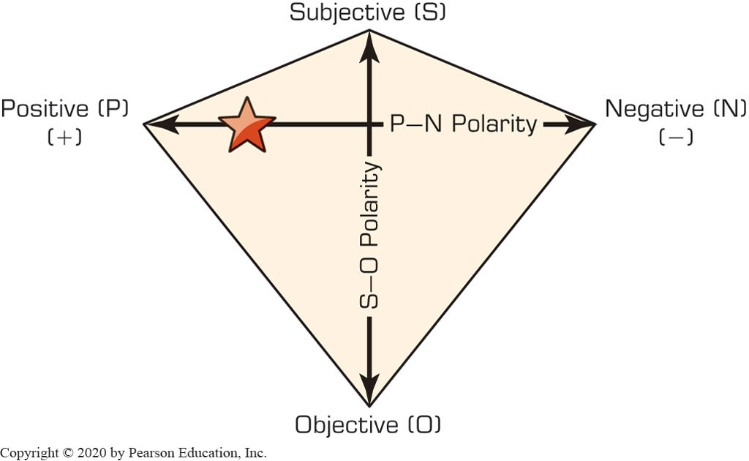
P-N Polarity and S-O Polarity

Slide 35
Web Mining Overview
Web is the largest repository of data
Data is in H T M L, X M L, text format
Challenges (of processing Web data)
The Web is too big for effective data mining
The Web is too complex
The Web is too dynamic
The Web is not specific to a domain
The Web has everything
Opportunities and challenges are great!

Slide 36
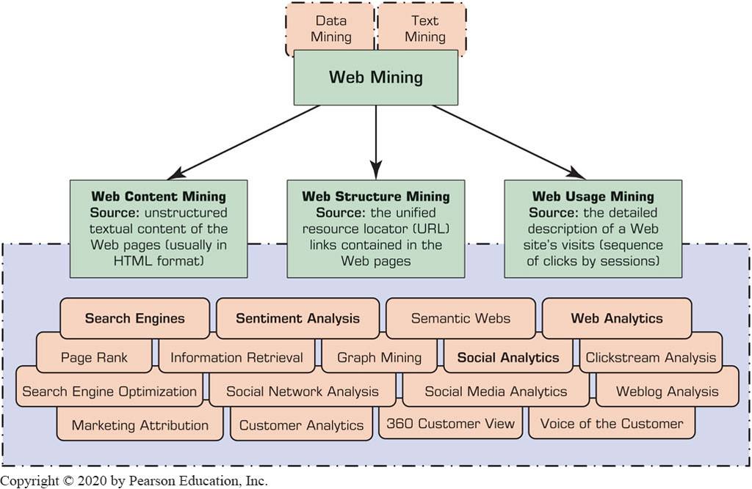
Web Mining
Web mining (or Web data mining) is the process of discovering intrinsic relationships from Web data (textual, linkage, or usage)

Slide 37
Web Content Mining
Web content mining refers to the extraction of useful information from Web pages (unstructured textual content).
Data collection via Web crawlers
Can be used for things like:
Competitive intelligence (collecting intelligence about competitors’ products, services, and customers).
Information/news/opinion collection.
Enhance the results produced by search engines.
Summarization.
Sentiment analysis.
Automated data collection and structuring for predictive modeling.

Slide 38
Web Structure Mining
Web pages include hyperlinks
Hyperlinks contain a significant amount of hidden human annotation
Authoritative pages
The collective endorsement of a given page by different developers on the Web might indicate the importance of the page and might naturally lead to the discovery of authoritative (centralized) Web pages
Hubs
One or more Web pages that provide a collection of links to authoritative pages (prominent sites on a specific topic of interest).
Hyperlink-induced topic search (H I T S) algorithm
A link-analysis algorithm that rates Web pages using the hyperlink information contained within them.
Used to calculate hubs and authorities

Slide 39
Web Usage Mining (1 of 3)
Also called Web Analytics
Extraction of information from data generated through Web page visits and transactions.
Clickstream data
data stored in server access logs, referrer logs, and client-side cookies
user characteristics and usage profiles
metadata, such as page attributes, content attributes, and usage data including time of access and duration
Clickstream analysis
Analysis of clickstream data, using data mining and text mining techniques to find interesting patterns in customer activities and periods and times of visits.

Slide 40
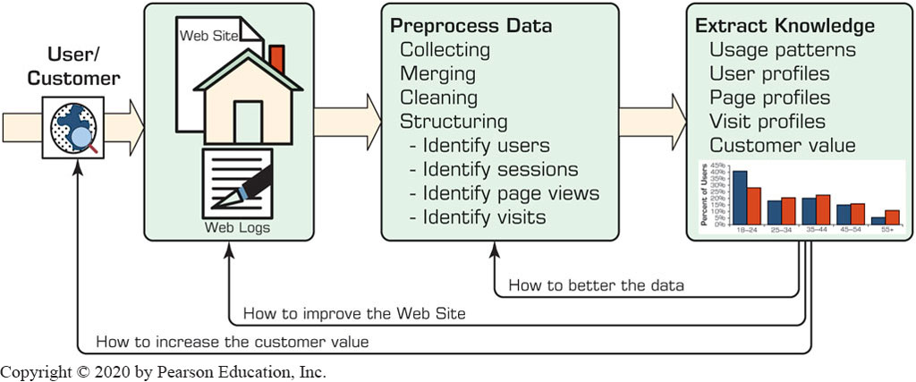
Web Usage Mining (2 of 3) (Clickstream Analysis)

Slide 41
Web Usage Mining (3 of 3)
Web usage mining applications
Determine the lifetime value of clients
Design cross-marketing strategies across products.
Evaluate promotional campaigns
Target electronic ads and coupons at user groups based on user access patterns
Predict user behavior based on previously learned rules and users’ profiles
Present dynamic information to users based on their interests and profiles

Slide 42
Search Engines
Google, Bing, Yahoo, …
For what reason do you use search engines?
Search engine is a software program that searches for documents (Internet sites or files) based on the keywords (individual words, multi-word terms, or a complete sentence) that users have provided that have to do with the subject of their inquiry
They are the workhorses of the Internet

Slide 43
Anatomy of a Search Engine
Two main cycles:
Development Cycle
Responding Cycle
Development Cycle Purpose
To create a huge database of documents/pages organized and indexed based on their content and information value.
Why? Due to its sheer size and complexity, searching the Web to find pages in response to a user query is not practical (or feasible within a reasonable time frame); therefore,
Search engines “cache the Web” into their database and use the cached version of the Web for searching and finding.
Once created, this database allows search engines to rapidly and accurately respond to user queries.

Slide 44
Anatomy of a Search Engine
Development Cycle Components
Web Crawler (spider)
a piece of software that systematically browses (crawls through) the Web for the purpose of finding and fetching Web pages.
Document Indexer
As the documents are found and fetched by the crawler, they are stored in a temporary staging area for the document indexer to grab and process.
The document indexer is responsible for processing the documents (Web pages or document files) and placing them into the document database.
Uses three steps:
Preprocessing the document
Parsing the document (text-mining tools & techniques)
Creating the term-by-document matrix

Slide 45
Anatomy of a Search Engine
Response Cycle Components
Query Analyzer
Responsible for receiving a search request from the user (via the search engine’s Web server interface)
Converting search request into a standardized data structure so that it can be easily queried/matched against the entries in the document database.
Document Matcher/Ranker
The structured query data are matched against the document database to find the most relevant documents/pages
Rank matched results in the order of relevance/importance.
Return list to user.

Slide 46
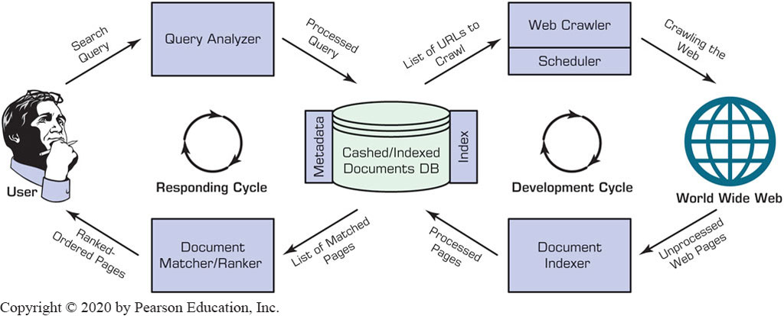
Structure of a Typical Internet Search Engine

Slide 47
Top 15 Most Popular Search Engines
(by eBizM B A, August 2016)
Rank | Name | Estimated Unique Monthly Visitors
1 | Google | 1,600,000,000
2 | Bing | 400,000,000
3 | Yahoo! Search | 300,000,000
4 | Ask | 245,000,000
5 | AOL Search | 125,000,000
6 | Wow | 100,000,000
7 | WebCrawler | 65,000,000
8 | MyWebSearch | 60,000,000
9 | Infospace | 24,000,000
10 | Info | 13,500,000
11 | DuckDuckGo | 11,000,000
12 | Contenko | 10,500,000
13 | Dogpile | 7,500,000
14 | Alhea | 4,000,000
15 | ixQuick | 1,000,000

Slide 48
Search Engine Optimization
It is the intentional activity of affecting the visibility of an e-commerce site or a Web site in a search engine’s natural (unpaid or organic) search results
Part of an Internet marketing strategy
Based on knowing how a Search Engine works
Content, H T M L, keywords, external links, …
Indexing based on …
Webmaster submission of U R L
Proactively and continuously crawling the Web

Slide 49

Copyright
This work is protected by United States copyright laws and is provided solely for the use of instructors in teaching their courses and assessing student learning. Dissemination or sale of any part of this work (including on the World Wide Web) will destroy the integrity of the work and is not permitted. The work and materials from it should never be made available to students except by instructors using the accompanying text in their classes. All recipients of this work are expected to abide by these restrictions and to honor the intended pedagogical purposes and the needs of other instructors who rely on these materials.

